Slide 1


Battle of Neighborhoods
Analysis of Italian Restaurants in New York City

Slide 2



Introduction
New York City is a mega diverse megalopolis which is growing fast
It is a melting pot of different cultures and hub of Italian Americans in USA
Italian cuisine is amongst the most popular across demographics
Combining these two aspects, analysis can be performed to track best places to open a new restaurant or the best place to eat Italian food

Slide 3
Problem Statement
The project aims to answer the following 4 questions
Most Italian restaurants by borough - This tells us if borough is saturated or if there is an opportunity to open a place with less competition
List of the most popular Italian chain restaurants – This is useful to an entrepreneur who wants to operate a franchise instead of an independent restaurant
Highest rated Italian restaurants - This gives a list of restaurants which are the highest rated by borough.
List restaurants by tips - A higher tip typically suggests a more upscale or high-end restaurant and vice-versa. This suggests a customer about a restaurant based on their lunch/ budget. It also tells a restauranteur about the type of restaurants in the neighborhood based on which they can take decisions.

Slide 4
DATA
I used two sets of data. One to collect location data and the other from the check-in based social media app Foursquare. I used an API belonging to Foursquare application to access the data set.
Location Data – I pulled location co-ordinate data from the following dataset - https://cocl.us/new_york_dataset
Foursquare API –
The Foursquare API provided me with restaurant information which is gathered via user check ins. The location data is the form a json file which contains the following details - Borough, Neighborhood, Latitude and Longitude.
The data pulled from the Foursquare API contains the following details - Italian restaurants by neighborhood, Name of the restaurant, Borough, Neighborhood, ID, Likes, Rating and Tips. The Foursquare API will use location data from the location dataset and select restaurant details.

Slide 5
Methodology
Create functions to collect location and venue data from the source datasets
Collect Data from the various sources and load into data frames
Perform data transformation where necessary
Build visualizations that provide answers to the problem set

Slide 6



RESULTS

Slide 7

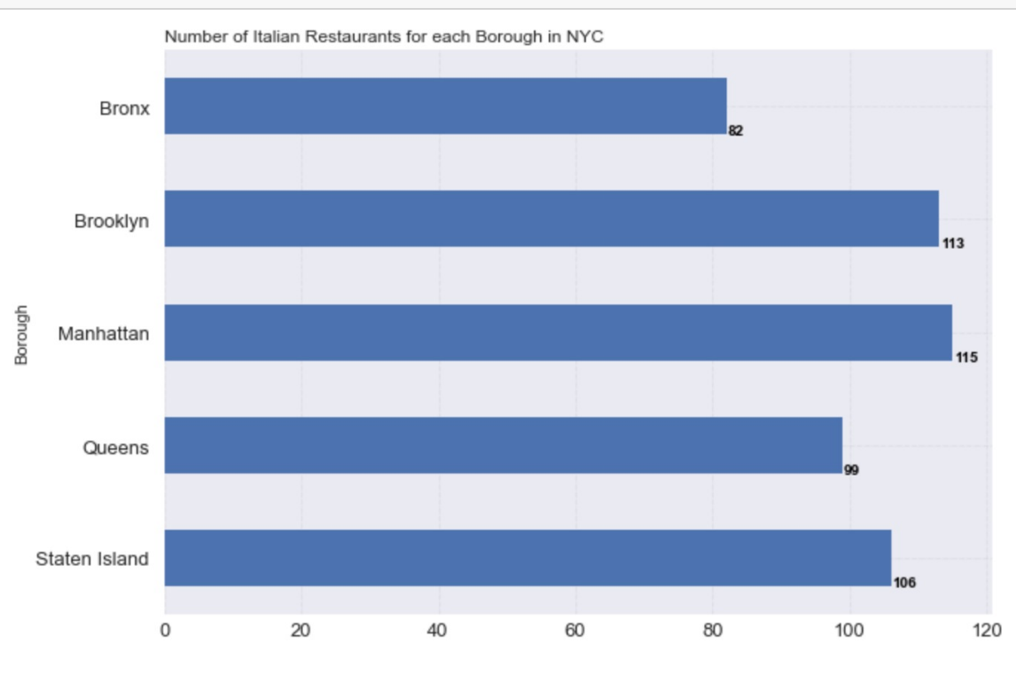

MOST ITALIAN RESTAURANTS BY BOROUGH
Manhattan, Brooklyn and Staten Island are the best places to eat and most saturated when it comes to opening a restaurant.
Queens and Bronx have less restaurants and so provide an opportunity to open a successful restaurant.

Slide 8
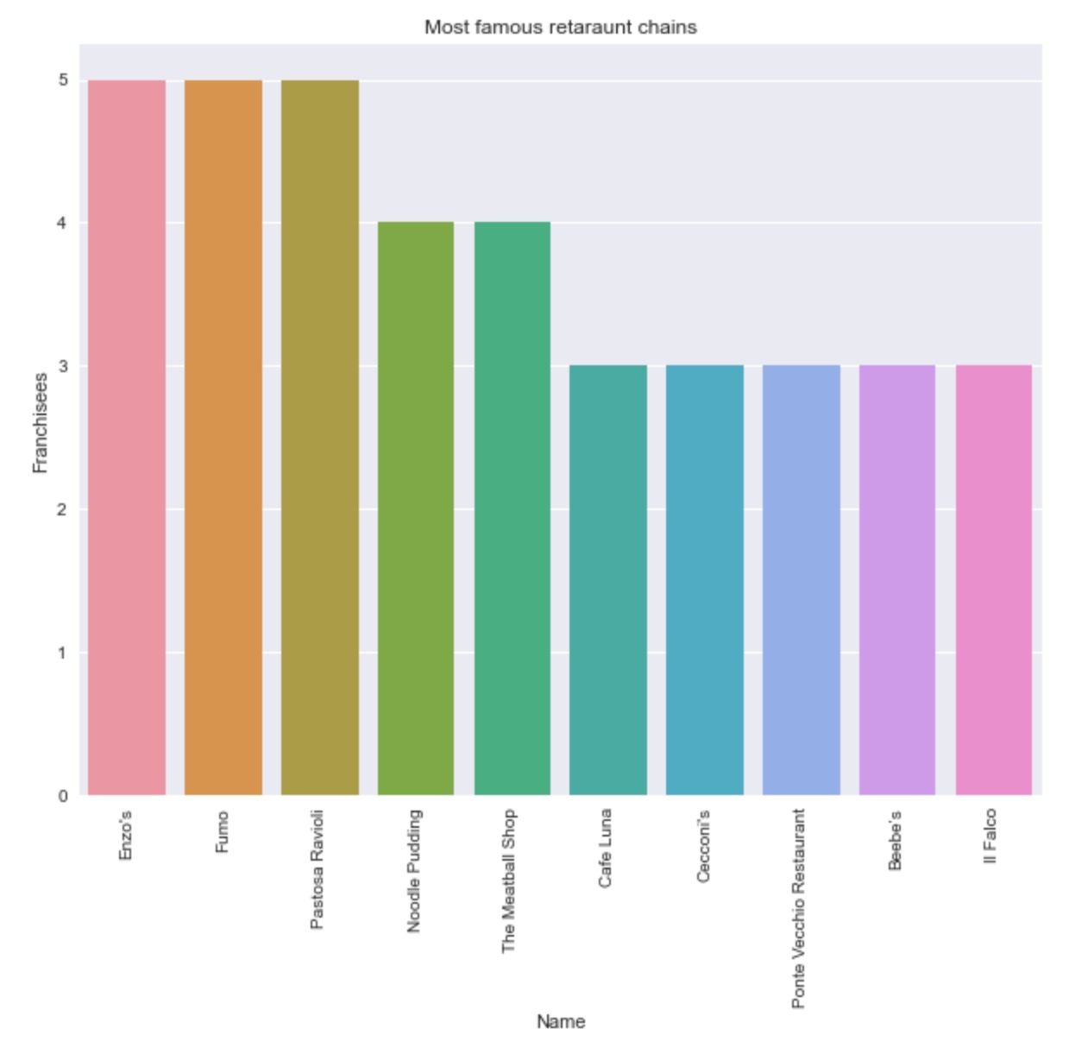
MOST POPULAR ITALIAN CHAIN RESTAURANTS
The most popular ones are Enzo’s and Fumo with 5 branches each.
This tell us that restaurants operating using franchise models are not very popular in NYC.

Slide 9
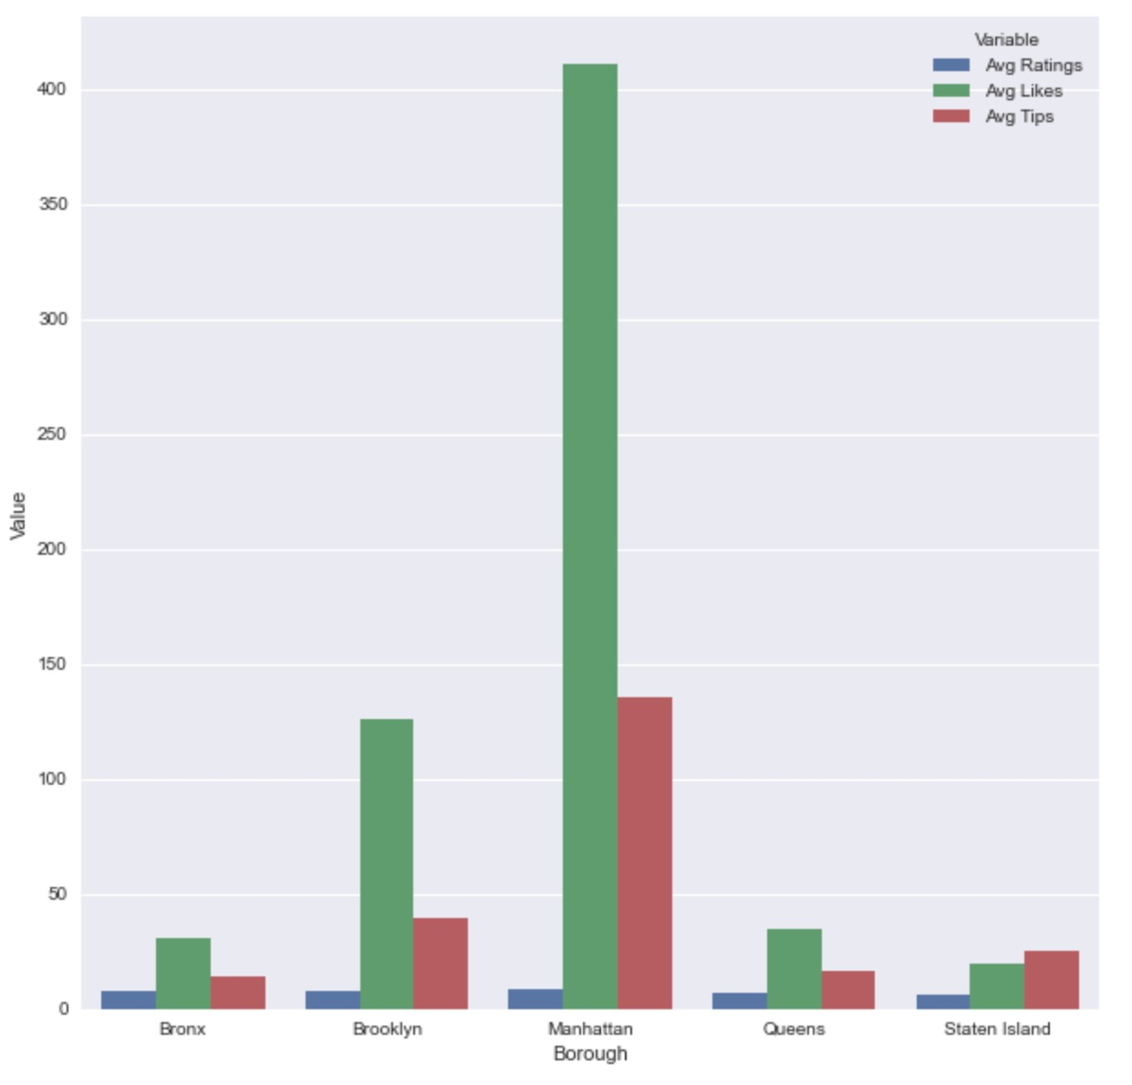
ITALIAN RESTAURANTS BY RATINGS AND TIPS
Manhattan has the restaurants with the most average likes and tips.
This suggests that the best restaurants are present in Manhattan followed by Brooklyn.
Manhattan on average has the most expensive restaurants followed by Brooklyn.
This also tells us that these two boroughs are the most affluent the populace is willing to spend money to eat in a good restaurant.

